Slide 1
Math 530/630: CM 4.4 Classical Inference: Hypothesis Testing

Slide 2
General idea for hypothesis testing
Partition the parameter sample space into two regions
One region is defined by the null hypothesis: H₀
Usually what you wish to see evidence against
If the parameter estimate based on my sample is null/dull, then it will fall in this region (given some reasonable amount of random variation)
Other region defined by the alternative hypothesis: H₁
Usually what you wish to see evidence in support of
If the parameter estimate based on my sample is interesting, then it will fall in this region (and thus, outside of the null/dull region)
This is traditional null hypothesis significant testing (NHST)
Also called reject-support hypothesis testing

Slide 3
General idea for a test statistic
A numerical summary used to collapse sample data into a single number
When “big” or “extreme”, suggests that the observed data is very unexpected under the null hypothesis H₀
A p-value quantifies this incompatibility between the data and H₀ – specifically, it’s a tail probability
So, to get a p-value, you must know or approximate the probability distribution of the test statistic under the null H₀
This means we need to know what the null sampling distribution looks like

Slide 4
General idea for an estimator
Point estimate is your single best guess at the parameter
Interval estimate, i.e. confidence interval, provides a set of possible values for that parameter value that are “compatible” with the data
Construction of confidence interval requires knowledge of the estimator’s distribution

Slide 5
Therefore…
To complete a hypothesis test or convey the precision of a point estimate, we need the statistic’s or estimator’s sampling distribution
“sampling” here should invoke “long-run”, “hypothetical repeats of the experiment”
For an estimator, the standard deviation of the sampling distribution is called the standard error

Slide 6
General idea for a p-value
Probability under the null H₀ of observing a test statistic value as or more extreme than that computed from the observed data (your sample data)
The p-value is not the probability that the null hypothesis is true
Example in a two-sided test, i.e. when both very small and very large values of test stat are “extreme”:

Slide 7
“A p-value is a measure of how embarrassing the data are to the null hypothesis”
--Nicholas Maxwell
Maxwell (2004). Data Matters: Conceptual Statistics for a Random World. Emeryville, CA: Key College Publishing.

Slide 8
Cut-offs
Whether we like to admit it or not, p-values ultimately are cut-offs:
p-value < 𝝰 | p-value ≥ 𝝰
Hit | Not hit
Statistically significant | Not statistically significant
Fame and glory! | ?
Reject H₀ | Accept H₀ (cringe) Fail to reject H₀ (eye-roll)

Slide 9
P-value
Standardized measurement of evidence
Measure of probabilistic significance, not conceptual.
LOW P-VALUE: low probability of sample looking like the null population
Decision → reject the null
HIGH P-VALUE: high probability of sample looking unlike the null
Decision → do not reject null

Slide 10
Process
Write down null and alternative hypotheses
Figure out good test statistic that estimates the parameter you are interested in (i.e., what numeric summary based on your sample captures what you want)
Work out null distribution for that statistic
Calculate p-value by comparing actual value to null distribution
Reject H₀ if p-value < 𝝰

Slide 11
Hypotheses
Null hypothesis = H₀
Alternative hypothesis = H_{a} / H₁
Hint: we have to know the null distribution, so H₀ will always be of the form:
Some parameter = some value as in…
µ = 0

Slide 12
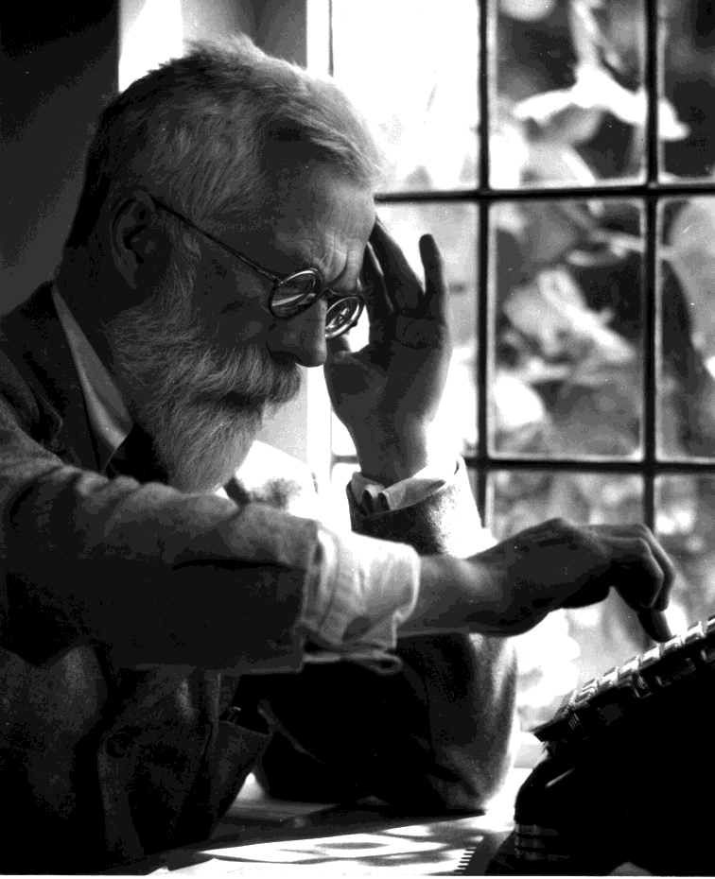
R. A. Fisher
A experiment by R. A. Fisher (famous early statistician, 1890-1962)
A lady at a tea party claims that she can tell the difference between putting the milk in first and second.
How can we be sure?

Slide 13

The lady tasting tea
Fisher set up an experiment
The lady (Muriel Bristol) was presented with 8 cups of tea
4 had tea with milk added second
4 had milk with tea added second
She was asked to select the 4 cups prepared by putting the milk in first and second.
First, how many “draws” can Muriel take of the 8 cups?

Slide 14


How many ways can Muriel choose?
8
4

Slide 15
What is the sample space?
Right | Wrong | # | %
4 | 0 |  | 1
3 | 1 |  | 23
2 | 2 |  | 51
1 | 3 |  | 23
0 | 4 |  | 1
Total |  |  | 100

Slide 16
Hypergeometric distribution (discrete)
Arguments
x, q vector of quantiles representing the number of white balls drawn without replacement from an urn which contains both black and white balls.
m the number of white balls in the urn. [cups with milk → tea]
n the number of black balls in the urn. [cups with tea → milk]
k the number of balls drawn from the urn. [number of “draws”]
p probability, it must be between 0 and 1.
nn number of observations. If length(nn) > 1, the length
is taken to be the number required.

Slide 17
The lady tasting tea
As the story goes, the lady identified all 4 cups correctly. What were the chances (exactly!)?
> dhyper(4, 4, 4, 4) # dhyper(x, m, n, k)
[1] 0.01428571
> 1 - phyper(3, 4, 4, 4) # phyper(q, m, n, k)
[1] 0.01428571

Slide 18
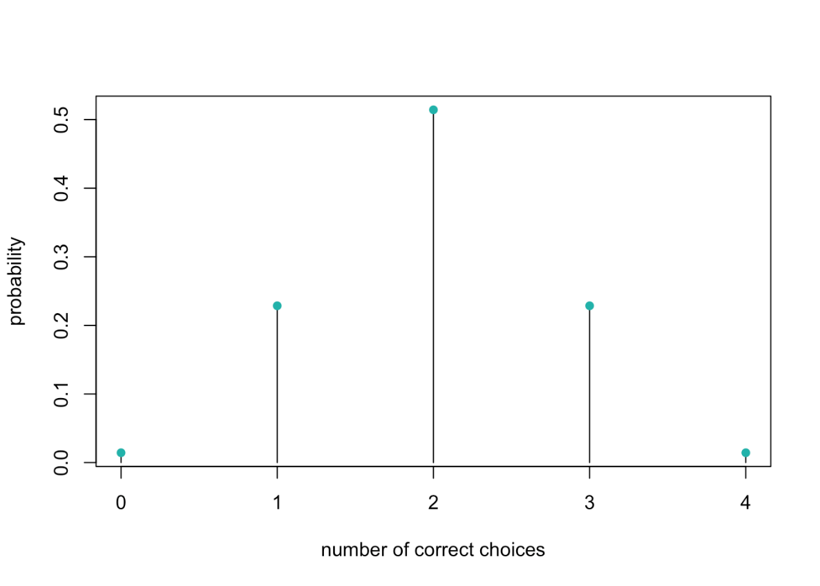
The lady tasting tea
As the story goes, the lady identified all 4 cups correctly. What were the chances (exactly!)?
> dhyper(4, 4, 4, 4)
[1] 0.01428571
> 1 - phyper(3, 4, 4, 4)
[1] 0.01428571

Slide 19
The lady tasting tea
The expected value of a hypergeometric variable is known to be:
k <- 4 # number of cups picked
m <- 4 # number of true “hits”
N <- 8 # total number of cups
k * (m/N) # population mean
[1] 2
What if we wanted to know whether Muriel was better than “average”, with 𝝰 = .05?

Slide 20
What if we wanted to know whether Muriel was better than “average”, with 𝝰 = .05?
What is the null hypothesis?
What is the alternative hypothesis?
What if we ramp up to 100 cups of tea?
What will accept as evidence of better than average?

Slide 21
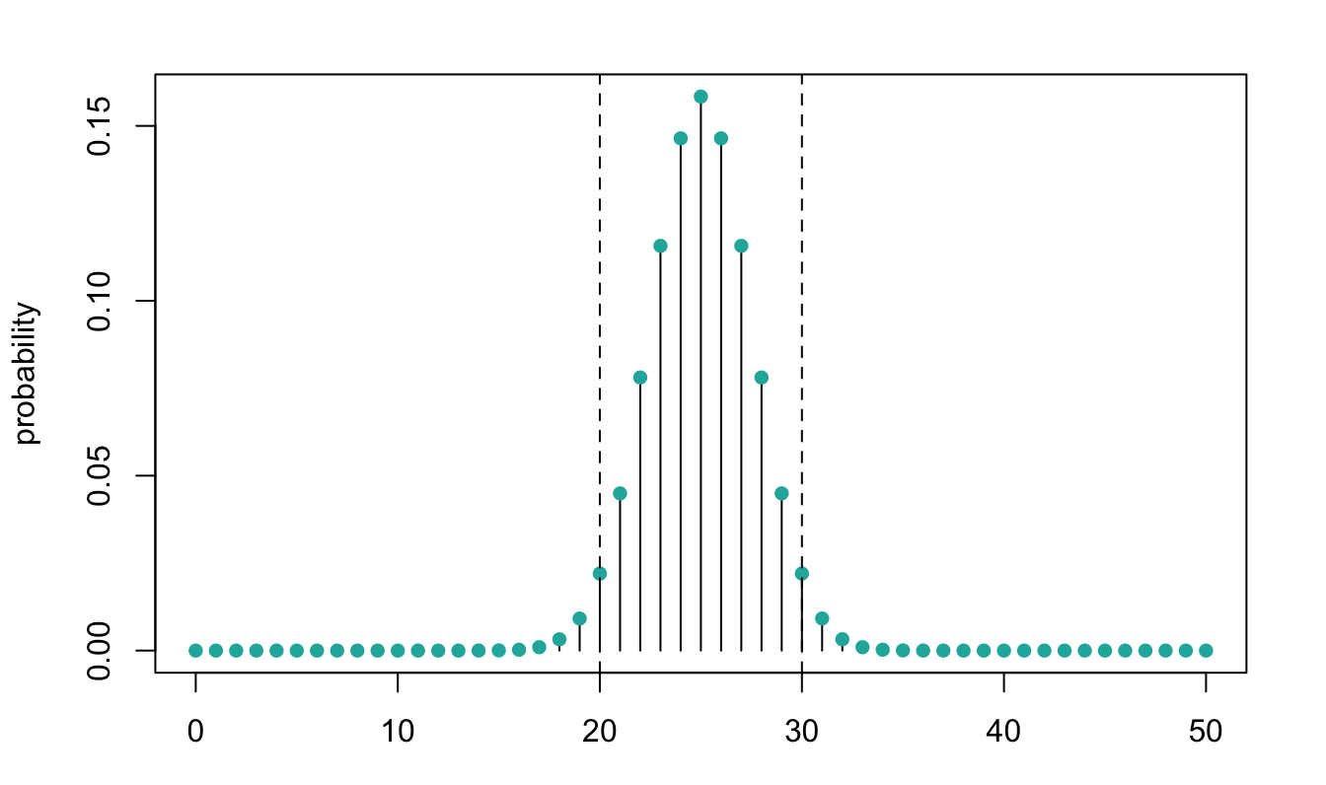
95% confidence interval for known µ with 100 cups
qhyper(.975, 50, 50, 50) # upper tail p = .025
[1] 30
qhyper(.025, 50, 50, 50) # lower tail p = .025
[1] 20
p = .025←
→ p = .025

Slide 22
What if Muriel got exactly 31 correct?
dhyper(31, 50, 50, 50)
[1] 0.009163535
p = .025←
→ p = .025

Slide 23
The null distribution
If we know the population distribution, we can construct the null distribution: the distribution of a test statistic if the null hypothesis is true
Here, Fischer figured out that the null distribution was hypergeometric- you may not always be so lucky!
If we don’t know the population distribution, we can simulate it using resampling
In the two sample scenario, this means we resample observations from our sample data without replacement, each time reshuffling the "sample" or "group" assignment.

Slide 24
Permutation testing
Idea: Simulate the sampling distribution under the null hypothesis by shuffling the group labels repeatedly and computing the desired statistic.
Motivation: If the labels really don't matter, then switching them shouldn't change the result! We do this when we want to test whether observations from two groups follows the same distribution, without making any assumptions about the shape of that distribution (e.g., normality).

Slide 25
From Chihara & Hesterberg:
Say that you have one sample with *m* observations, and a second sample with *n* observations
Pool the m + n values
Repeat…
Draw a resample of size m without replacement
Use the remaining n observations for the other sample
Calculate the difference in means or another statistic that compares samples
…until you have enough samples
Calculate the p-value as the fraction of times the random statistics exceed the original statistic (note: “Exceeds” generally means ≥ rather than >)
Multiple by 2 for a two-sided test, or use abs()

Slide 26
The star-bellied sneetches

Slide 27

Remember, statistics…
2 main reasons we love them:
Sometimes they are estimators for population parameters we care about
Sometimes they are test statistics, i.e. the basis for a hypothesis test

Slide 28
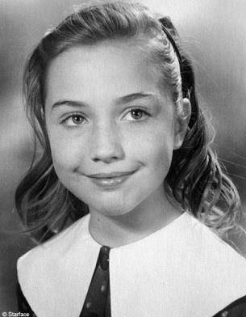
Aspiring astronauts
Inspired by Alan Shepard, the first American to journey into space, a 14-year-old Hillary Rodham from suburban Chicago wrote a letter to NASA in 1961 asking what she needed to do to become an astronaut.

Slide 29

Let’s pretend
Upon receipt of the letter in 1961, NASA decided to conduct a study to test whether girls who are aspiring astronauts in high school have “above average” IQ

Slide 30
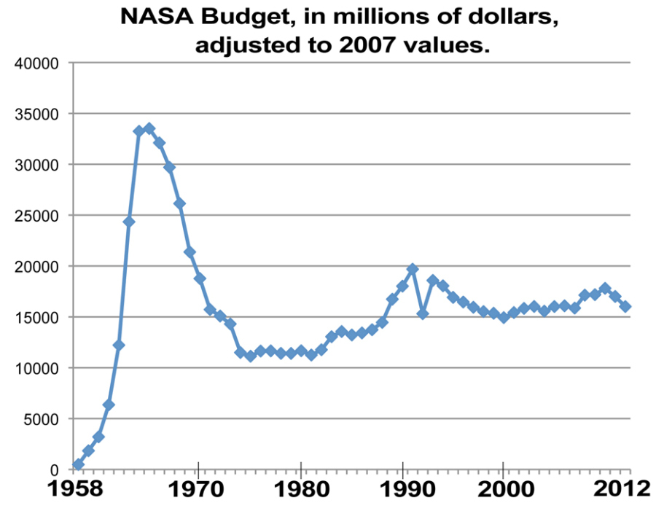
The (fictitious) study
Unfortunately, the NASA budget in 1961 was pretty low
So they studied only 25 high school girls, all of whom were aspiring astronauts (AA)
Population (normally distributed): µ = 100; 𝞼 = 15

Slide 31

A (directional) alternative hypothesis
H₀:
AA will have lower or comparable IQs;
H₁:
AA will have higher IQs;

Slide 32
Rearrange…
H₀:
AA will have lower or comparable IQs;
H₁:
AA will have higher IQs;

Slide 33
Obtaining a test statistic
Recall that we know the population mean and variance/standard deviation
Remember our general formula for any test statistic about some generic parameter, θ:

Slide 34
Let’s pretend we live in a crazy 1960’s world, and NASA interns calculated just the sample mean and not the standard deviation before they “lost” the data. Luckily, we know µ and 𝞼.
What is the NULL distribution of this test statistic?

Slide 35
Before we even look at the data: What is the mean and standard deviation (the “standard error”) of the null distribution? What shall we assume this distribution looks like? Draw it! Let 𝝰 = .05, 1- tailed: What value does our sample mean need to “beat” in order for us to conclude that it is higher than the population mean (given random variation present in our sample)? Draw this! What would you conclude if our sample mean is 104? What if it is 108?
Your Turn

Slide 36
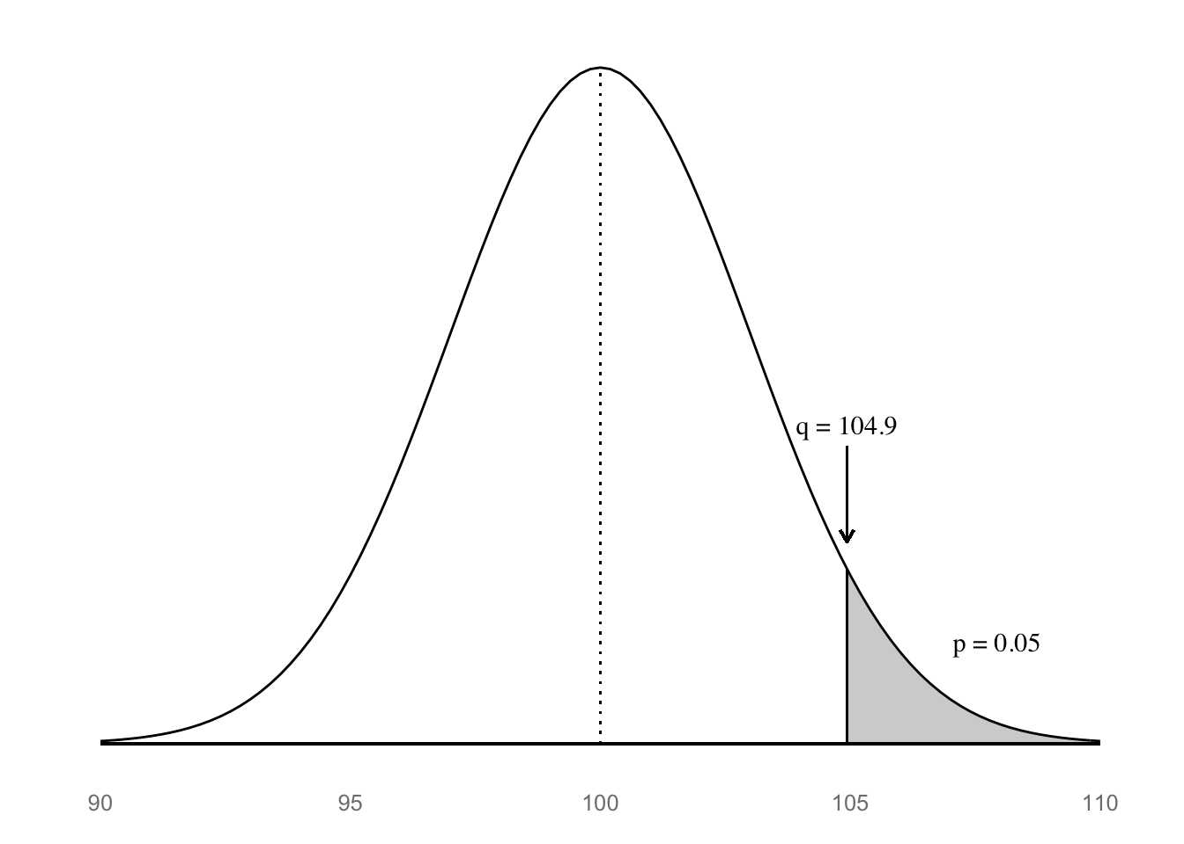
The null distribution for the z-statistic

Slide 37
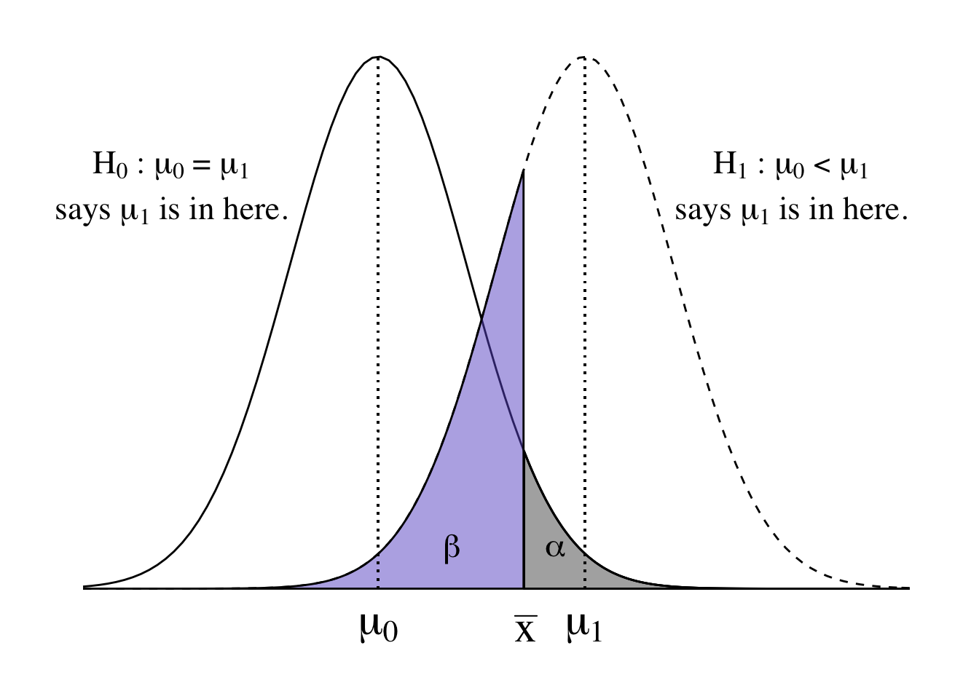

Slide 38
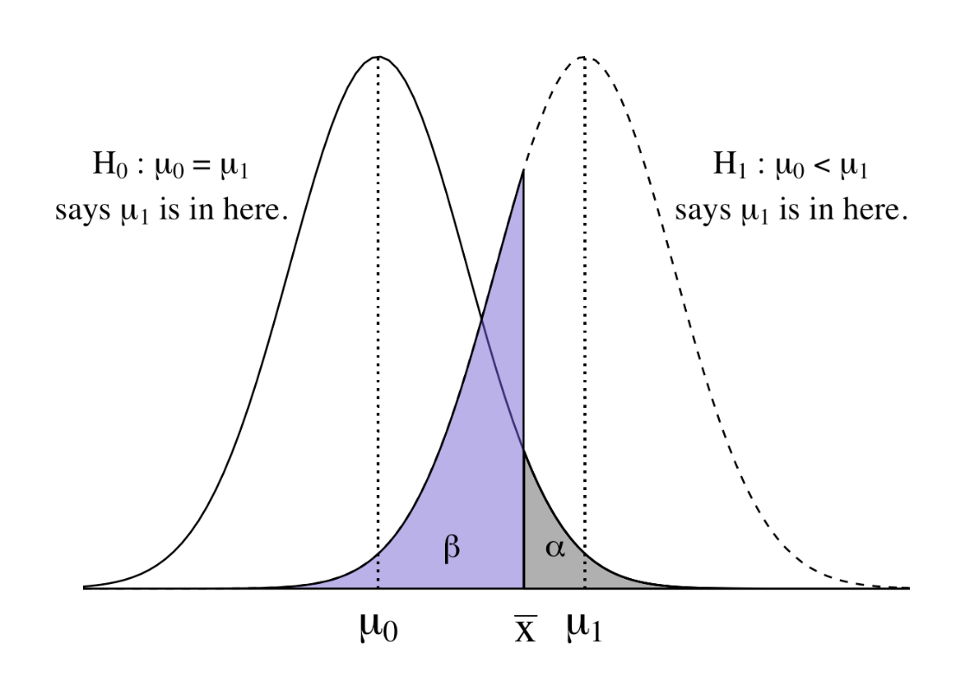
Dueling distributions
In a one-tailed test, we have two dueling hypothetical distributions:
The null distribution, centered at µ₀
The alternative distribution, centered around some specific or unspecified other mean (higher or lower?) µ₁

Slide 39
A (non-directional) alternative hypothesis
H₀:
IQ scores for AA will not differ from population;
H₁:
IQ scores for AA will be different from population;

Slide 40
Before we even look at the data: What is the mean and standard deviation (the “standard error”) of the null distribution? What shall we assume this distribution looks like? Draw it! Let 𝝰 = .05, 2- tailed: What value does our sample mean need to “beat” in order for us to conclude that it is different than the population mean (given random variation present in our sample)? Draw this! What would you conclude if our sample mean is 105?
Your Turn

Slide 41
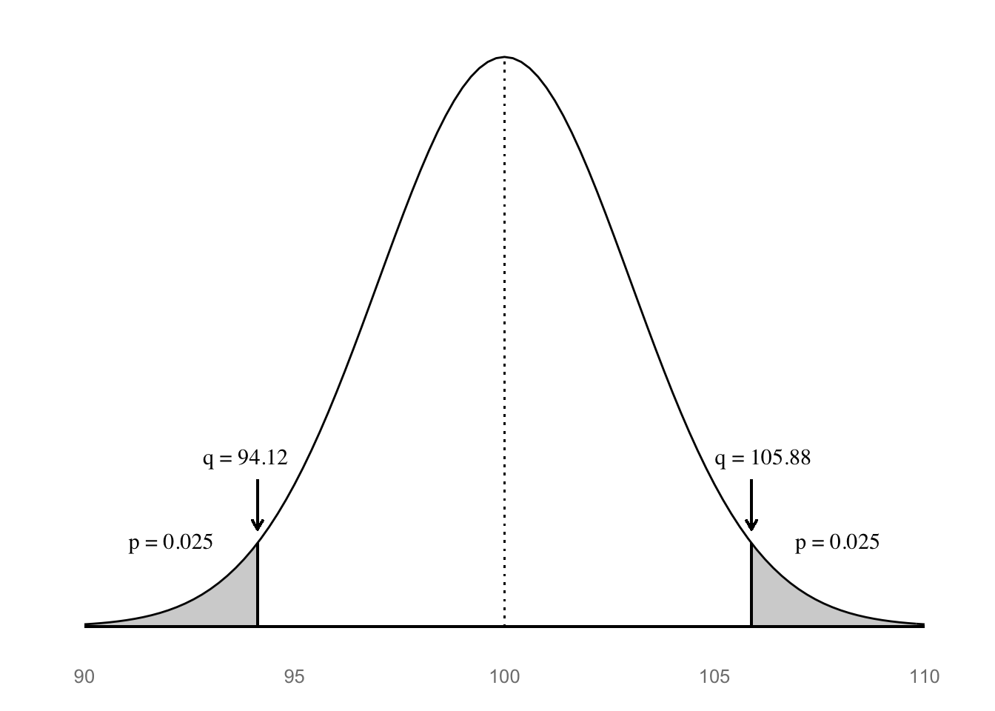
The null distribution for the z-statistic

Slide 42
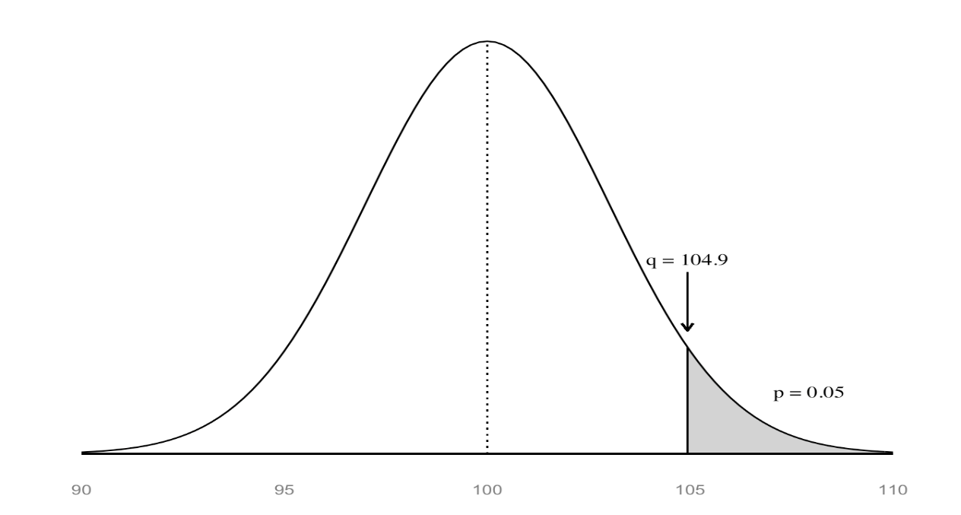

The alternative hypothesis
Directional H₁
Non-directional H₁
1 tailed
2 tailed

Slide 43
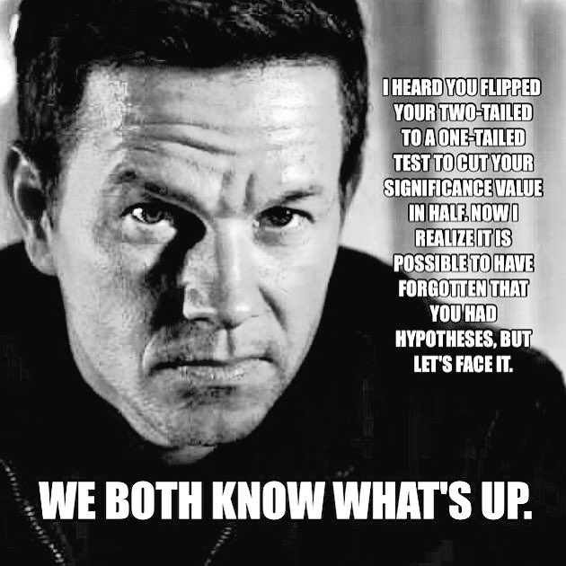

Slide 44

And the sample mean is…

Slide 45
One-sample z-test
For known:

Slide 46
One-sample z-test
For known:

Slide 47
From wikipedia…
The p-value is defined as the probability, under the assumption of the null hypothesis, of obtaining a result equal to or more extreme than what was actually observed.
Depending on how it is looked at, the "more extreme than what was actually observed" can mean
X ≥ x (right-tail event) or
X ≤ x (left-tail event) or
the "smaller" of X ≤ x and X ≥ x (double-tailed event).
Thus, the p-value is given by
Pr(X ≥ x|H) for right tail event,
Pr(X ≤ x|H) for left tail event,
2*min{Pr(X ≤ x|H),Pr(X ≥ x|H)} for double tail event.

Slide 48
http://math.stackexchange.com/questions/1493880/two-tailed-hypothesis-test-why-do-we-multiply-p-value-by-two

Slide 49
One-sample z-test
Does sample perform differently than general population (known: μ & σ)?
Now what?
Determine z_{critical} values for your α
Must “beat” ±1.64 for α = .10, 2-tailed, to reject null
Must “beat” ±1.96 for α = .05, 2-tailed, to reject null
Must “beat” ±2.32 for α = .01, 2-tailed, to reject null

Slide 50

Obtaining the p-value
One-tailed
pz_up <- 1 - pnorm(z)
Two-tailed
pz_2 <- 2*pz_up
c(pz_up, pz_2)
[1] 0.04779035 0.09558070

Slide 51
Obtaining the p-value
One-tailed
pz_up <- 1 - pnorm(z)
Two-tailed
pz_2 <- 2*pz_up
c(pz_up, pz_2)
[1] 0.04779035 0.09558070

Slide 52
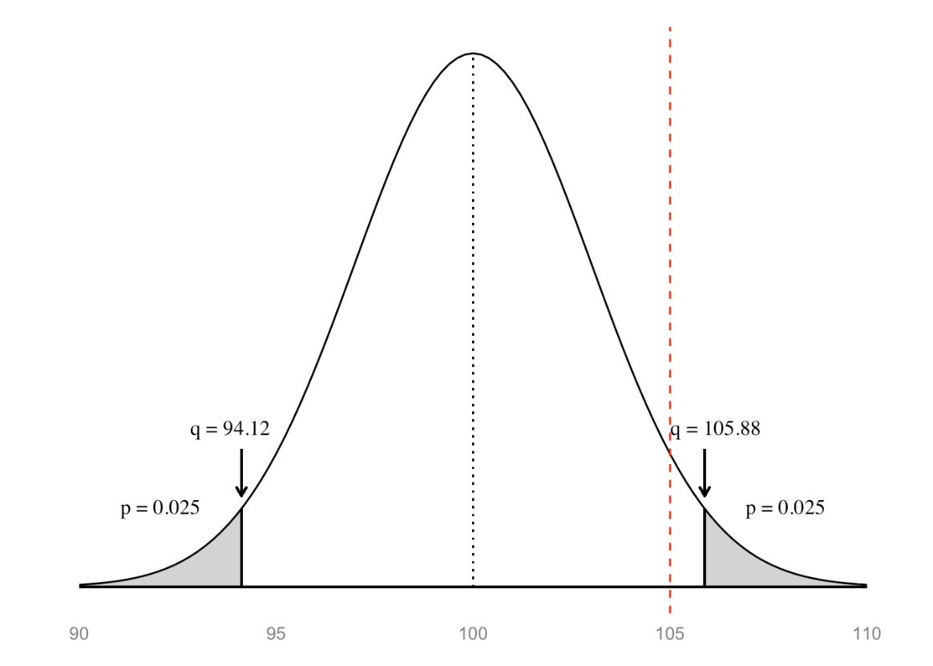
Two-tailed p-values more generally…
pz_1tail <- min(pnorm(z), 1 - pnorm(z))
pz_2tail <- 2 * pz_1tail
pz_2tail
[1] 0.0955807
→ p = .0955

Slide 53
When the null hypothesis is true
1-sample z-test
n = 25

Slide 54
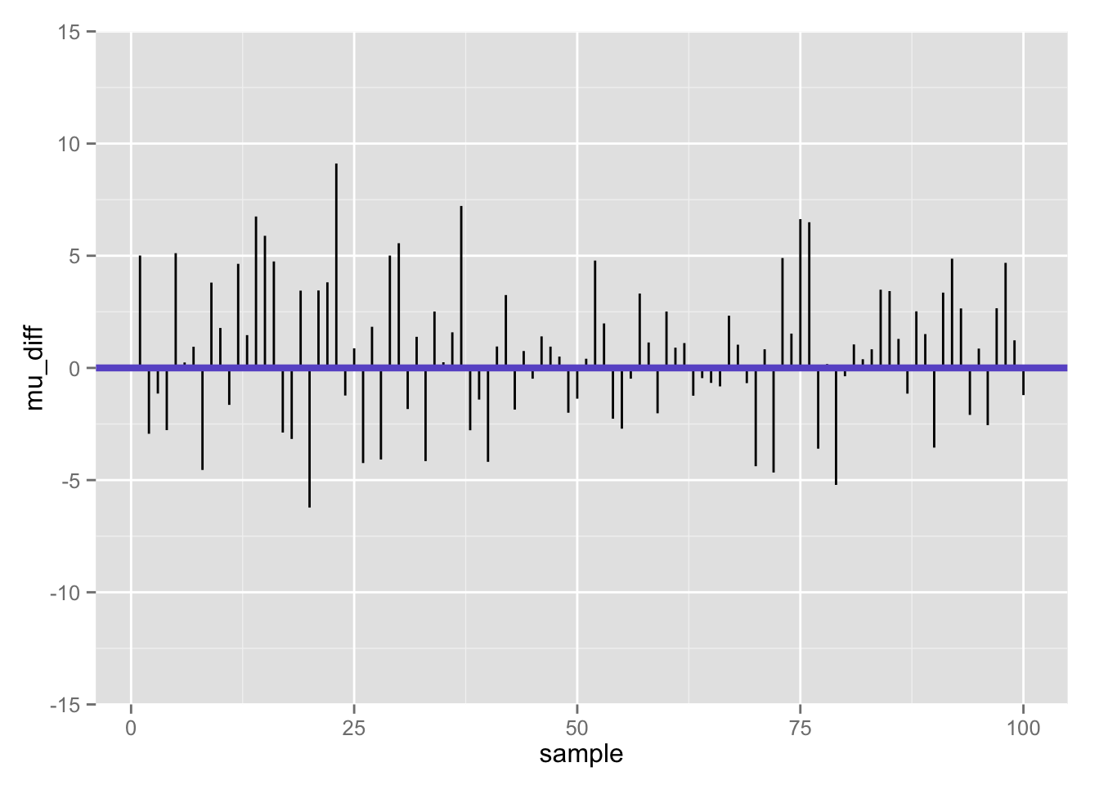
Differences between population mean and sample mean (100 samples) when null is true

Slide 55
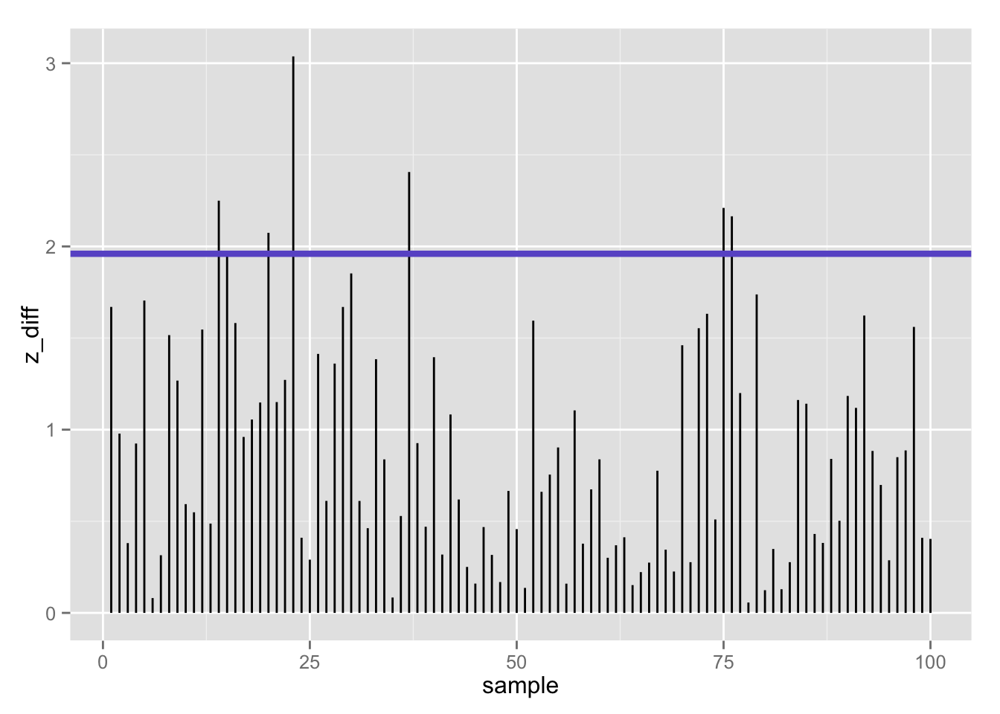
100 z-statistics (absolute value) when null is true: 7% false positives using z-test (𝛂 = .05/2)

Slide 56
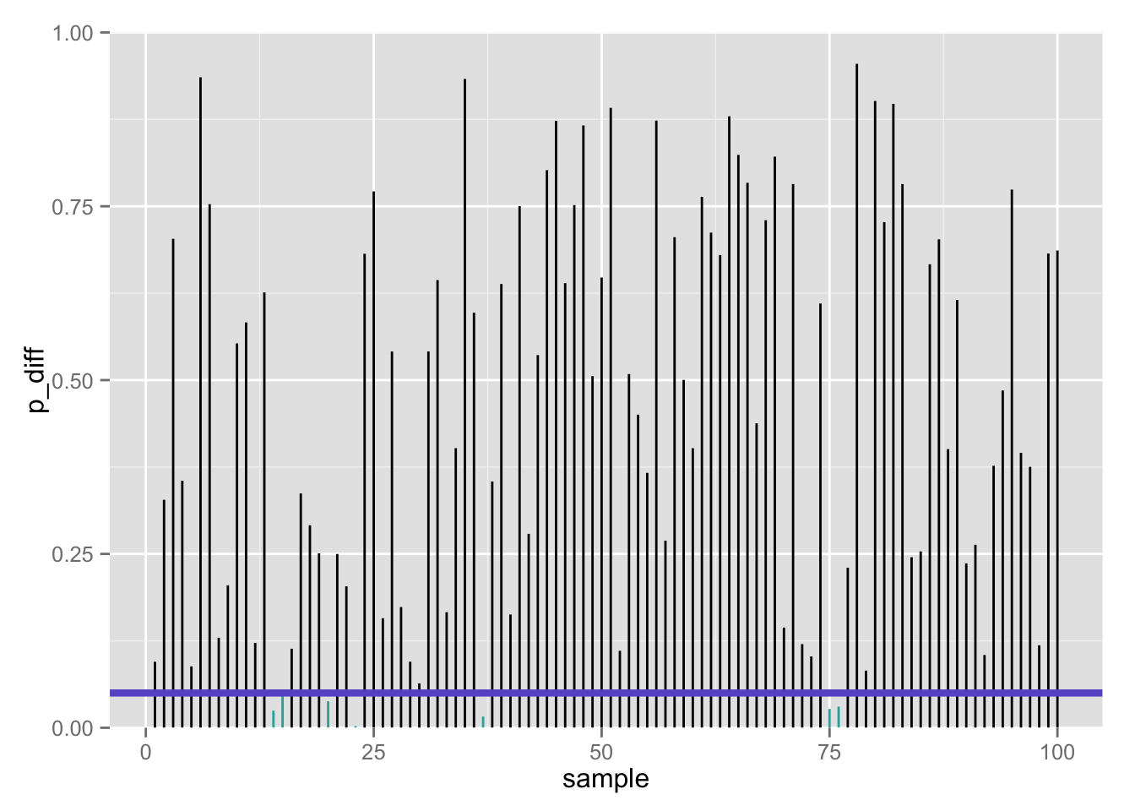
100 p-values when null is true: 7% false positives using z-test (𝛂 = .05/2)

Slide 57
Confusion matrix
 | Call based on observed data
True state of the world | Fail to reject H₀ | Reject H₀
H₀ | True negative 1 – 𝝰 | False positive Type I error 𝝰 | # true H₀’s
H₁ | False negative Type II error 𝛃 | True positive 1 – 𝛃 | # true H₁’s
 |  | # rejected H₀’s | # total tests
If the null is true…

Slide 58
Confusion matrix
 | Call based on observed data
True state of the world | Fail to reject H₀ | Reject H₀
H₀ | True negative 1 – 𝝰 | False positive Type I error 𝝰 | # true H₀’s
H₁ | False negative Type II error 𝛃 | True positive 1 – 𝛃 | # true H₁’s
 |  | # rejected H₀’s | # total tests
But… what if we are wrong??

Slide 59
“Statistics does not tell us
whether
we are right. It tell us the
chances
of being wrong.”
http://www.nature.com/nmeth/journal/v10/n9/full/nmeth.2613.html

Slide 60


Two ways we can be wrong…
Type 1 error (𝛂)
False positive
Type II error (𝛃)
False negative
“You’re not pregnant”
“You’re pregnant”

Slide 61
One way we can be wrong…
Type 1 error (𝛂)
False positive
Call: reject H₀
If we had rejected the null, it is of course possible that we should not have!
That is, the true state of the world may be H₀ (he’s not pregnant), but our sample data leads us to reject H₀ and (incorrectly) conclude that he’s pregnant
This is really embarrassing, so we control this: 𝛂 = ?
“You’re pregnant”

Slide 62
The other way we can be wrong…
Call: fail to reject H₀
Type II error (𝛃)
False negative
If we conclude that we cannot reject the null, it is of course possible that we should have!
That is, the true state of the world may be H₁ (she’s pregnant), but our sample data says we don’t have good enough evidence to reject H₀ (she’s not pregnant)
“You’re not pregnant”

Slide 63
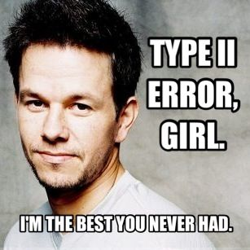
Type II errors
The one(s) that got away…

Slide 64







In our aspiring astronauts example…
Type 1 error (𝛂)
False positive
Type II error (𝛃)
False negative
Decide:
“You are smarter than average!”
Reality:
but you are actually not
Decide:
“You’re not smarter than average!”
Reality:
but you are actually

Slide 65
What if: the null hypothesis is FALSE?
1-sample z-test
n = 25

Slide 66
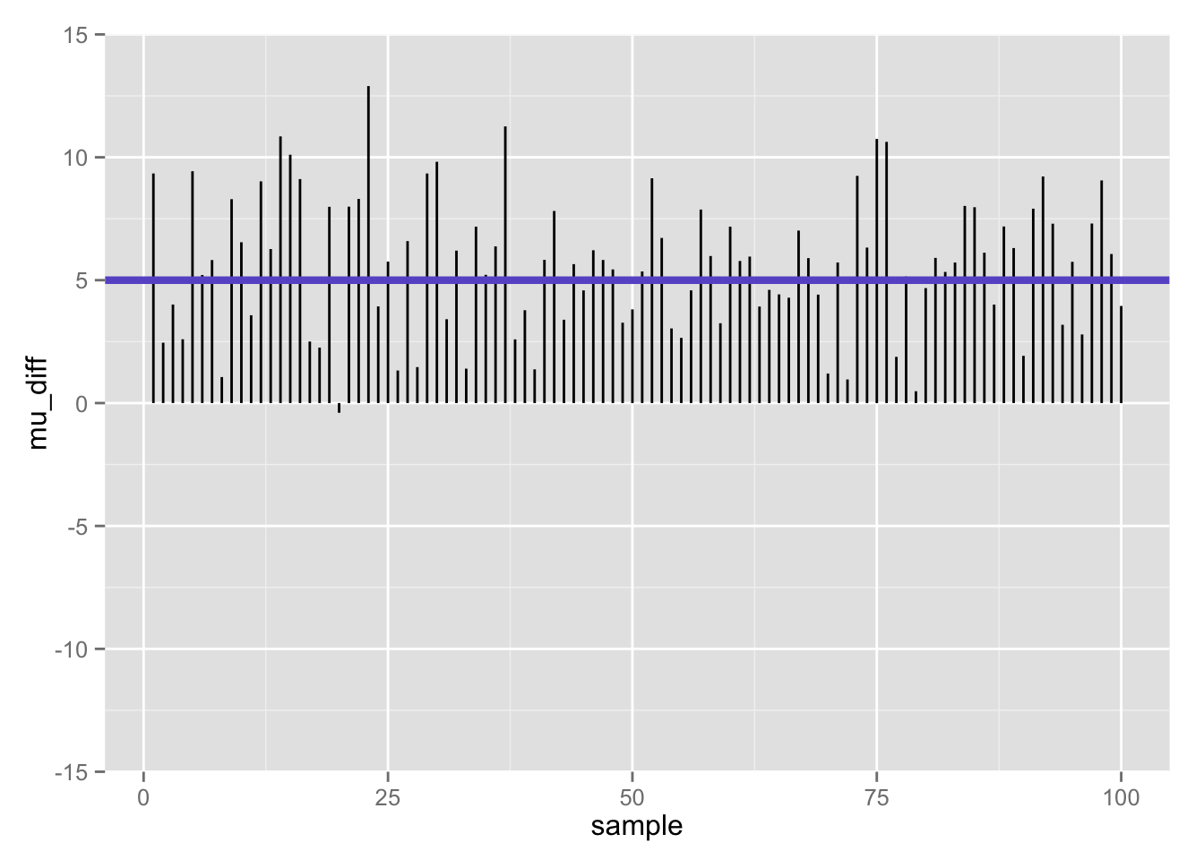

Slide 67
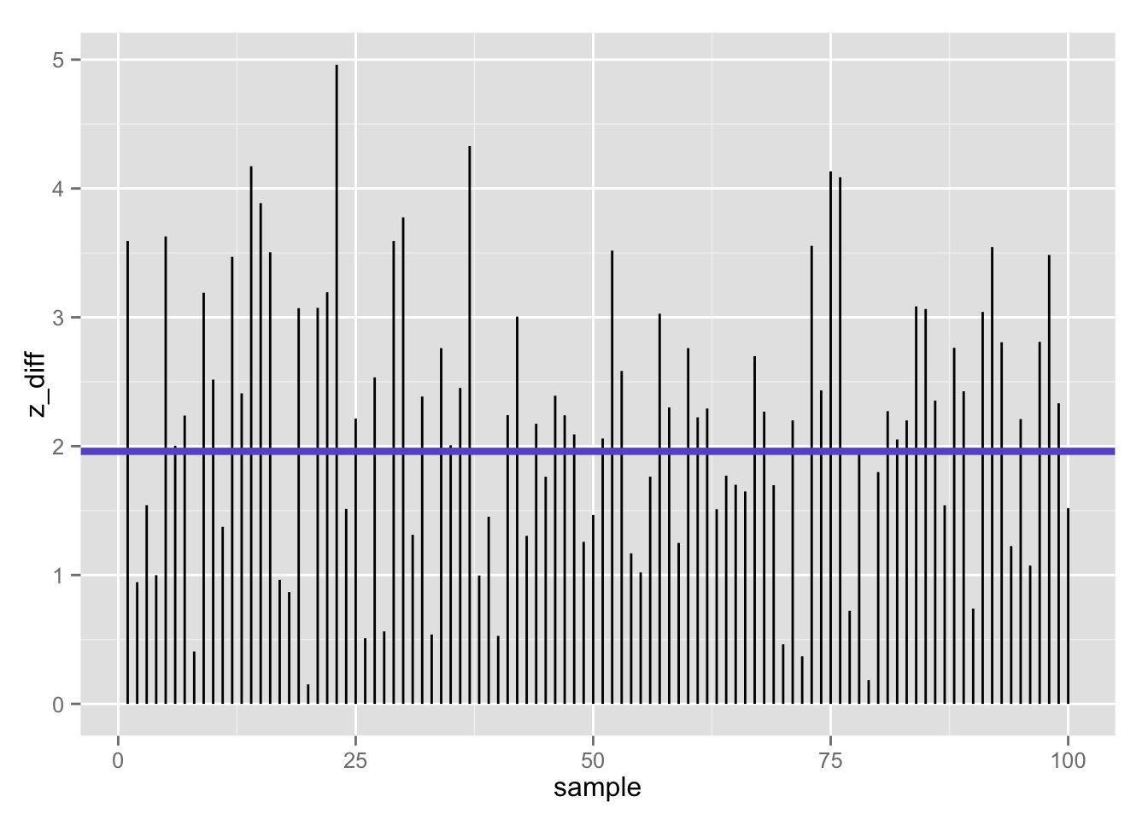
100 z-statistics (absolute value) when null is false: 39% false negatives using z-test (𝛂 = .05/2)
Flip side (1 −𝛃):
61% true positives

Slide 68
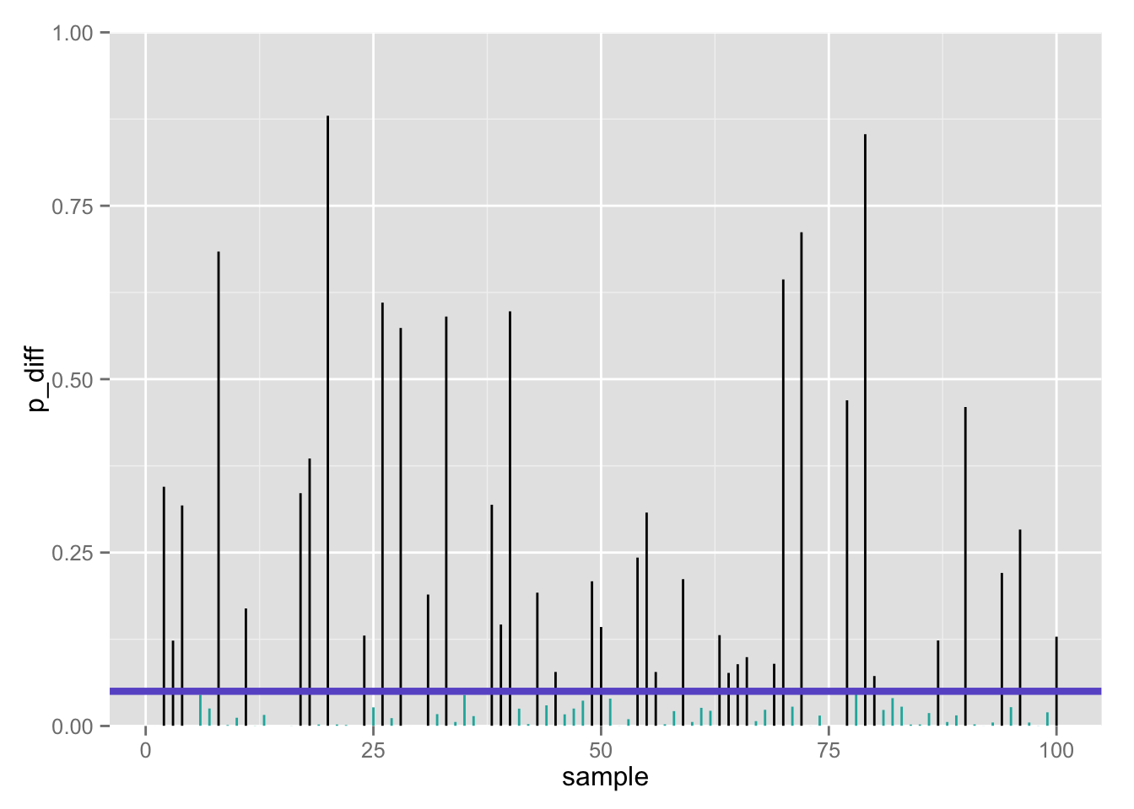
100 p-values when null is false: 39% false negatives using z-test (𝛂 = .05/2)
Flip side (1 −𝛃):
61% true positives

Slide 69
Now let’s vindicate our poor NASA interns: we have found the actual sample data, and now can calculate both the sample mean and standard deviation. We’ll use the sample standard deviation (s = 13) to estimate the population s.d. (𝞼).
What is the NULL distribution of this new test statistic?

Slide 70
Obtaining a test statistic
Remember our general formula for any test statistic about some parameter, θ:

Slide 71
One sample means T test

Slide 72
One-sample t-test

Slide 73
One-sample t-test

Slide 74
One-sample t-test
Does sample perform differently than general population (known: μ, unknown: σ)?
Now what?
Determine t_{critical} values for your α and df
Must “beat” that value to reject null

Slide 75
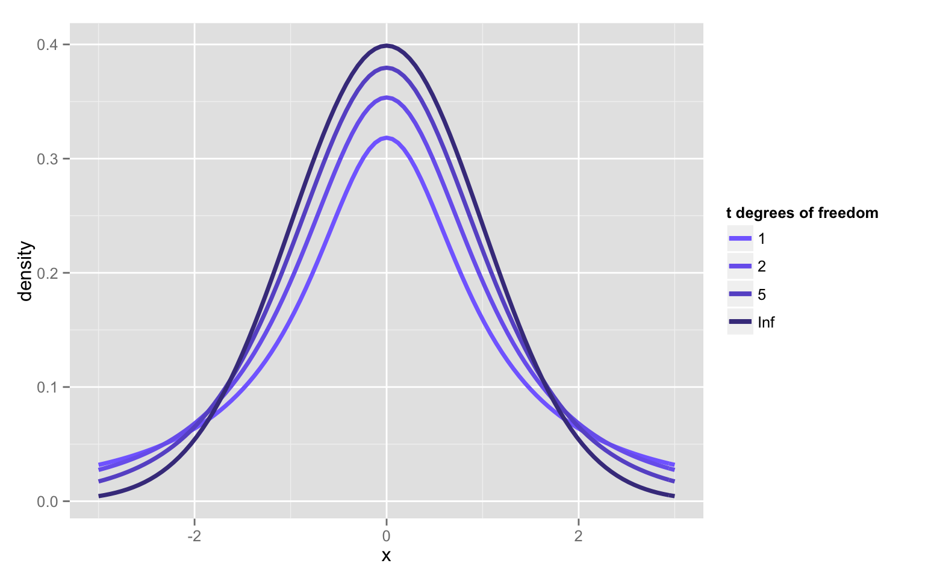
New distribution family: student’s t

Slide 76
The t-distributions: PDFs
Symmetric (skewness = 0)
Bell-shaped, but notice that the t always has always has relatively more AUC in the tails vs. the unit-normal, and unit-normal has relatively more scores in the center; thus t-distribution is leptokurtic
Kurtosis is undefined for t-variables with df < 4
On your own, at what N and df is the kurtosis of a t-variable = 3 (= to kurtosis of normal distribution)?

Slide 77
The t-distributions
Let T denote a random variable with a t-distribution with df degrees of freedom. Then:
E(T) = 0; same as unit-normal
Var(T) = df/(df-2); more spread out than unit-normal (↑ variance)
As df increases, the t- distributions converge to the unit normal.
t-distributions will be useful for statistical inference for one or more populations of quantitative variables.

Slide 78
Using the sample estimate of the variance
Recall the sample estimate of the population variance:
The t-statistic formula is:
At this point, you may be worried about the effect of variability of the variance estimate
You would be right: the random variable, t, is no longer normally distributed
It has a unique distribution: the t-distribution, with n-1 degrees of freedom
The t-distribution is asymptotically normal

Slide 79
Red = z, blue = t
n = 4 (×10,000 simulations)
n = 9 (×10,000 simulations)

Slide 80
Red = z, blue = t
n = 16 (×10,000 simulations)
n = 25 (×10,000 simulations)

Slide 82
Q-Q Plots of rt(100,df)
t with df=4
t with df=30

Slide 83
What is the p-value for the t statistic?
One-tailed, upper
pt_up <- 1 - pt(t, n – 1)
Two-tailed
pt_2 <- 2 * pt_up
c(pt_up, pt_2)
[1] 0.03320682 0.06641363

Slide 84
What is the p-value for the t statistic?
One-tailed, upper
pt_up <- 1 - pt(t, n – 1)
Two-tailed
pt_2 <- 2 * pt_up
c(pt_up, pt_2)
[1] 0.03320682 0.06641363

Slide 85
Two-tailed p-values more generally…
pt_1tail <- min(pt(t, n - 1), 1 - pt(t, n - 1))
pt_2tail <- 2*pt_1tail
pt_2tail
[1] 0.06641363

Slide 86
Family of t-tests
One-sample t-test for a single mean
Two-sample t-test (independent samples) for comparing 2 means
Two-sample t-test (correlated samples; dependent samples) for comparing 2 means with correlated or repeated measures

Slide 87
Interpreting significance in NHST
Non-significance ≠ true null hypothesis
Suppose we fail to reject the null because p > .05
We cannot assume then that null is true, but merely that we lack sufficient evidence to reject it
It is all too easy to find non-significant results by conducting…
A poor study…
With poor measures…
And low power.
Consider: “Not guilty” verdict in a jury trial- prosecutor may have failed to present a strong case
Not guilty ≠ innocent
If you truly want to support the null, look into equivalence testing/tests of close fit

Slide 88
Constructing a confidence interval for µ

Slide 89
Calculating 95% CI for µ in R, 𝞼 unknown
# sample statistics
xbar <- 105
s <- 13
n <- 25
# margin of error
me <- qt(.975, n - 1) * (s/sqrt(n)) # .975 --> .025 at EACH tail
# 95% confidence intervals
lowert <- xbar - me
uppert <- xbar + me
c(lowert, uppert)
[1] 99.63386 110.36614
Two-tailed CI
Is µ = 100 in there??

Slide 90
Calculating 95% CI for µ in R, 𝞼 unknown
# sample statistics
xbar <- 105
s <- 13
n <- 25
# margin of error
me <- qt(.975, n - 1) * (s/sqrt(n)) # .975 --> .025 at EACH tail
# 95% confidence intervals
lowert <- xbar - me
uppert <- xbar + me
c(lowert, uppert)
[1] 99.63386 110.36614
Two-tailed CI

Slide 91
One-sample t-test in R
Have to have actual data- not just sample statistics
So far, I have only been playing with sample statistics- I didn’t actually have sample data! Let’s make up some sample data with the sample mean/sd we need:
set.seed(1)
iq_aa <- seq(83.8, 126.2, length.out = 25)
mean(iq_aa) # perfect!
[1] 105
sd(iq_aa) # close enough!
[1] 13.00231

Slide 92
One-sample t-test in R
aat <- t.test(iq_aa, mu = 100) # Ho: mu = 100
aat
One Sample t-test
data: iq_aa
t = 1.9227, df = 24, p-value = 0.06646
alternative hypothesis: true mean is not equal to 100
95 percent confidence interval:
99.63291 110.36709
sample estimates:
mean of x
105
# Recall our previous 95% confidence interval- pretty close!
c(lowert, uppert)
[1] 99.63386 110.36614
Two-tailed test

Slide 93

Mansplain it to me…
devtools::install_github(c("hilaryparker/explainr", "hilaryparker/mansplainr"))
mansplain(aat)
That's great that you were able to do a hypothesis test. You got a p-value of 0.066459. That means it's not significant at alpha = .05, but that's OK. The important thing is that you tried.

Slide 94

Complain about it…
devtools::install_github(c("hilaryparker/explainr", "hilaryparker/complainr"))
complain(aat)
This hypothesis test had a p-value of 0.0664587.
That's if you can trust any frequentist method. You should really be doing a Bayesian analysis. Did you hear about that journal that banned p-values?

Slide 95
Rationale for one sample T test
We collect sample data and calculate a sample mean.
If this sample come from the population we think it came from, then we would expect the sample mean to be approximately equal to the population mean.
Although they may differ by chance, we would expect large differences between sample means to happen infrequently.
Under the null hypothesis, we assume no difference in means.
We compare the the sample mean to the population mean to see if the difference is more than we would expect to get by chance under the null hypothesis.

Slide 96
Rationale for one sample T test
At alpha=.05, we therefore seek evidence that there is only a 5% chance that the magnitude of the difference we observe is consistent with what we would expect based on chance alone.
Remember: The *p*-value does not tell you if the result was due to chance. It tells you whether the results are consistent with being due to chance. These two things are not the same.
We use the standard error as the gauge of variability of the sample mean. If it is small, we expect most samples to have very similar means. If it is large, then large differences in sample means are more likely.

Slide 97
Rationale for one sample T test
If the difference between the sample means is larger than we would expect based on the standard error, then we know that one of two things has happened:
We made a mistake (boo!). There is no difference between the population and our sample means fluctuate a lot. By chance, we have collected a sample that is atypical of the population we drew from. Here, the difference is a fluke and the null is true; we incorrectly reject the true null hypothesis and thus commit a Type I error.
We made a discovery (yay!). The sample comes from a different population, that may be typical of THAT population. Here, the difference is genuine, and we correctly reject the null hypothesis.

Slide 98
When the null hypothesis is true
1-sample t-test
n = 25

Slide 99
Differences between population mean and sample mean (100 samples) when null is true

Slide 100
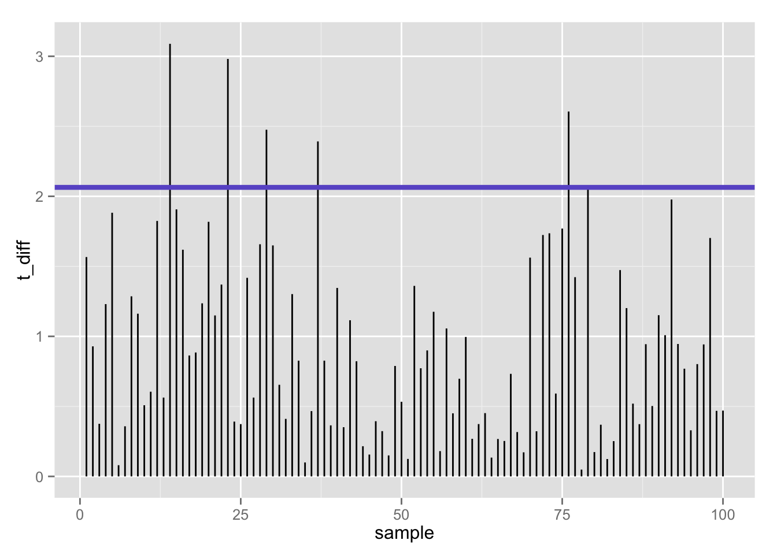
100 t-statistics (absolute value) when null is true: 5% false positives using t-test (𝛂 = .05/2)

Slide 101
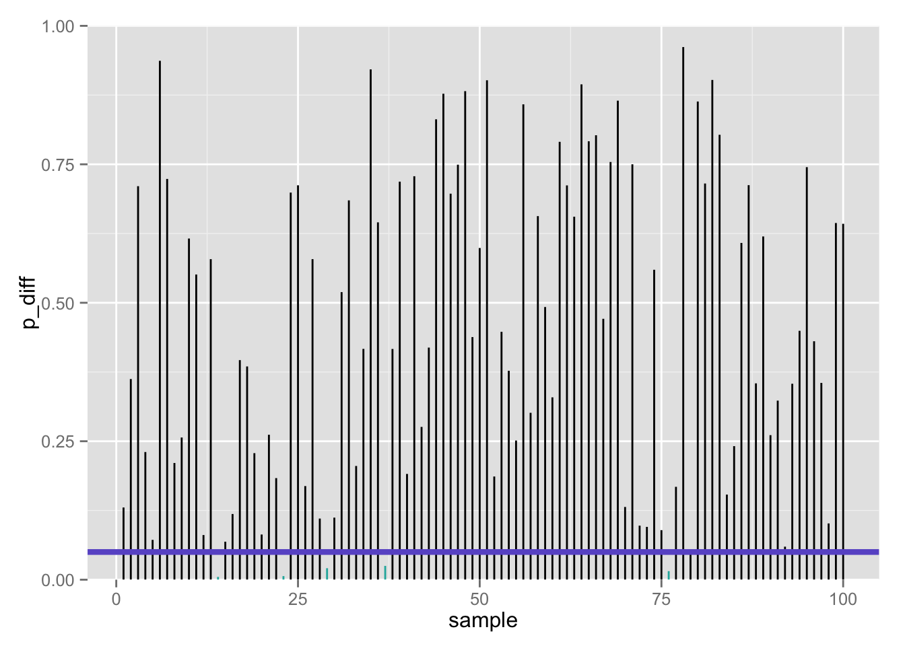
100 p-values when null is true: 5% false positives using t-test (𝛂 = .05/2)

Slide 102
What if: the null hypothesis is FALSE?
1-sample t-test
n = 25

Slide 103
Differences between population mean and sample mean (100 samples) when null is false

Slide 104
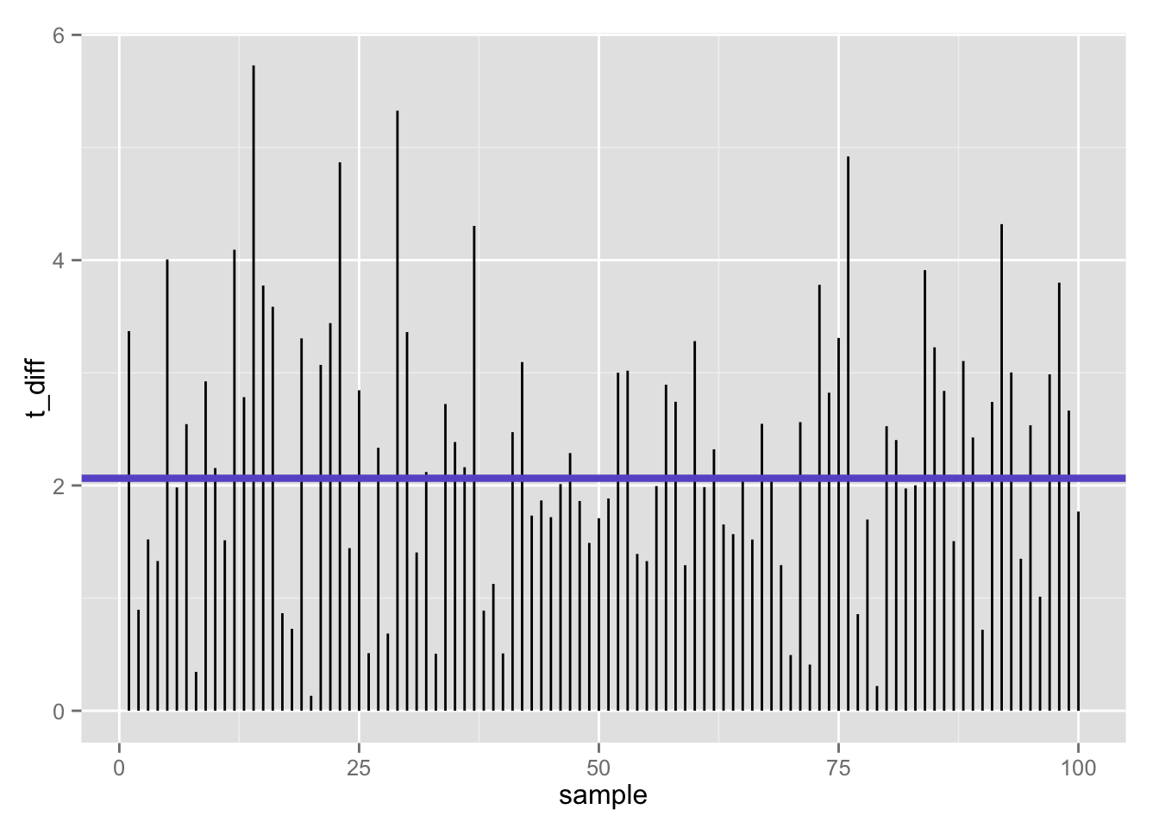
100 t-statistics (absolute value) when null is false: 47% false negatives using t-test (𝛂 = .05/2)
Flip side (1 −𝛃):
53% true positives

Slide 105
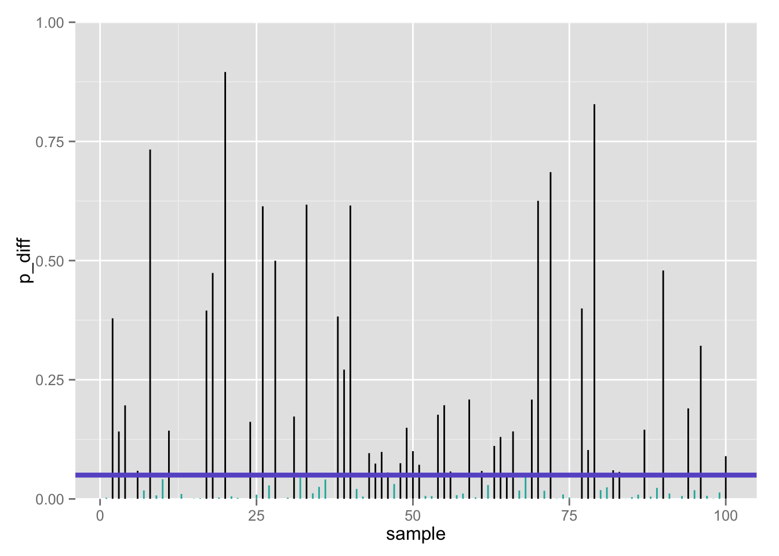
100 p-values when null is false: 47% false negatives using t-test (𝛂 = .05/2)
Flip side (1 −𝛃):
53% true positives

Slide 106

≈ 50% true positives seems low…
Only about half of our true effects would be detected in our study
Why?
Perhaps we lacked statistical power

